Slide 1
3x2 Roman Data Challenge
Tyler Brown
Advisor: Dr. Tim Eifler
Space Grant Symposium April 18th

Slide 2
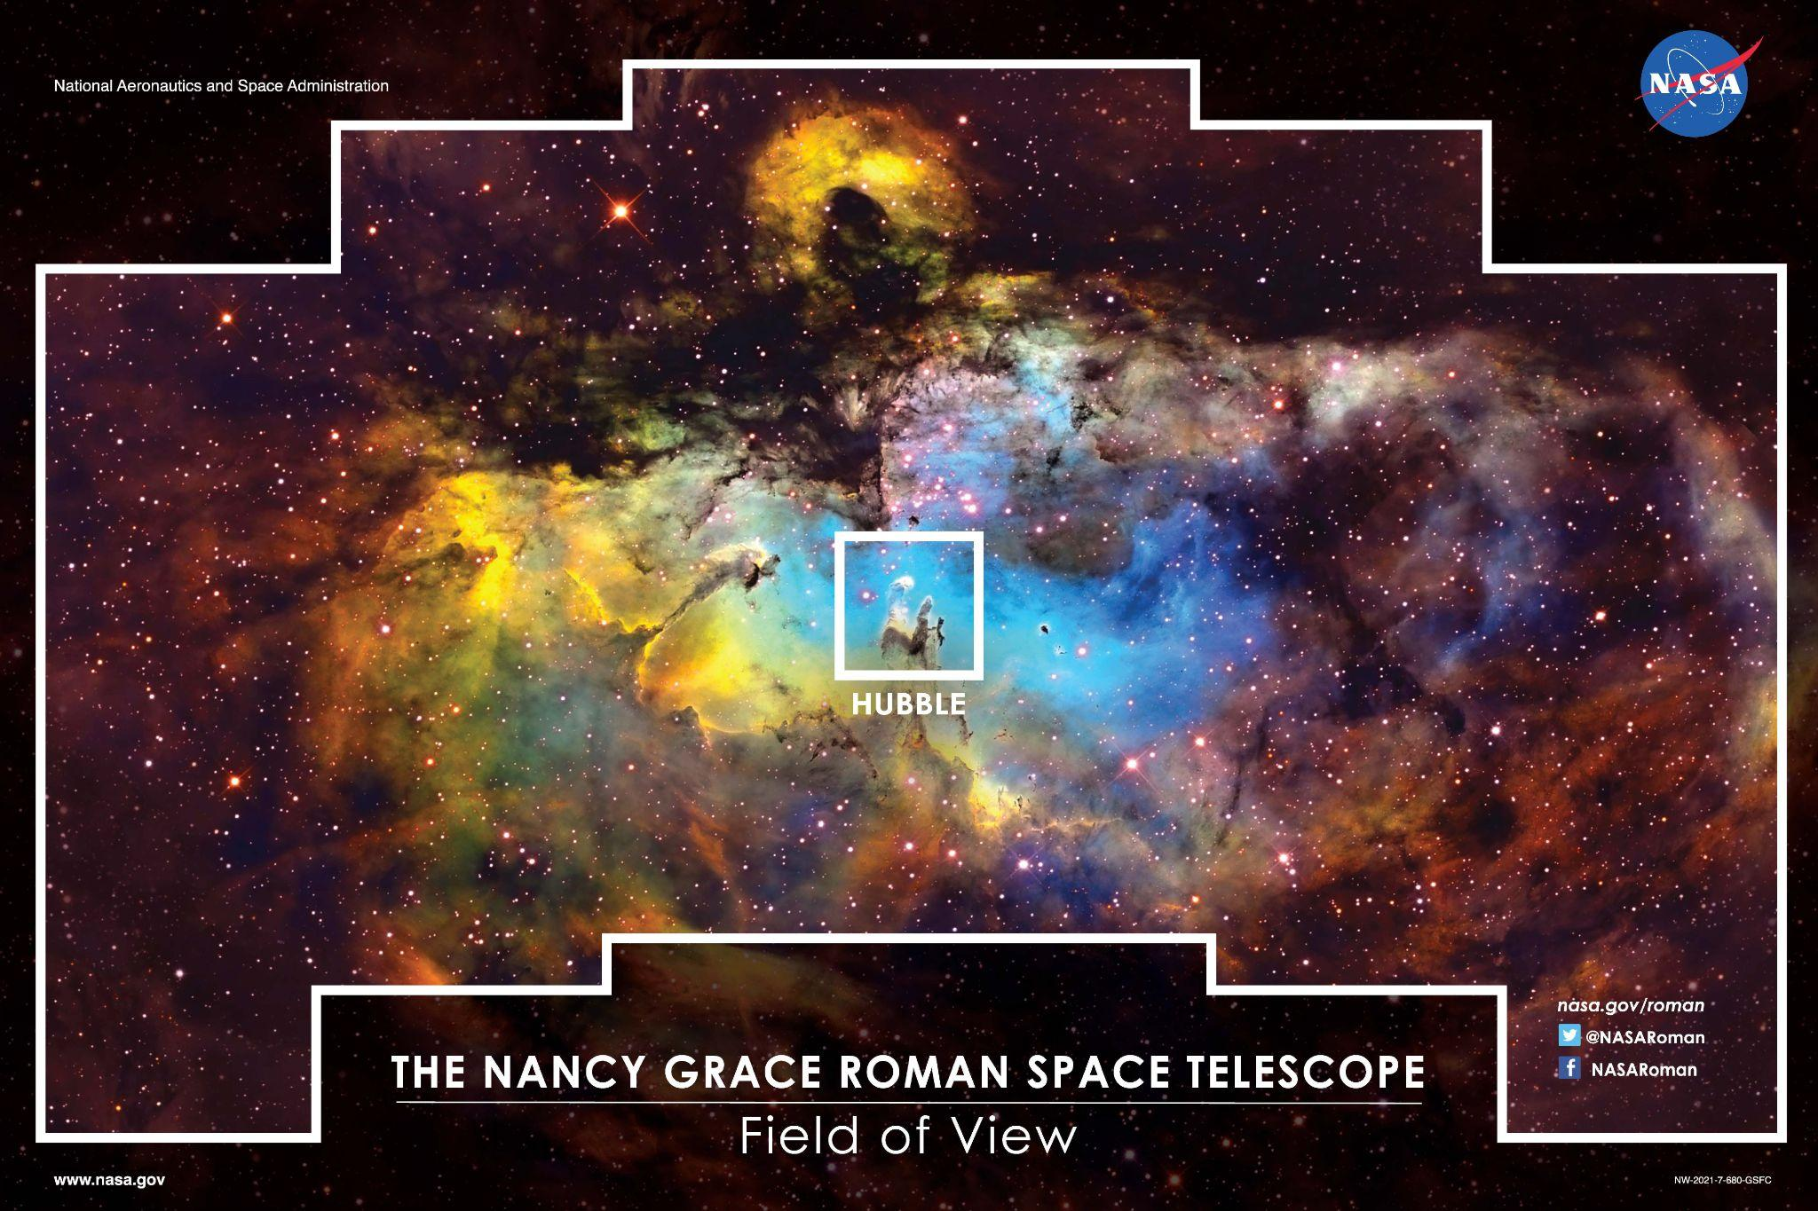
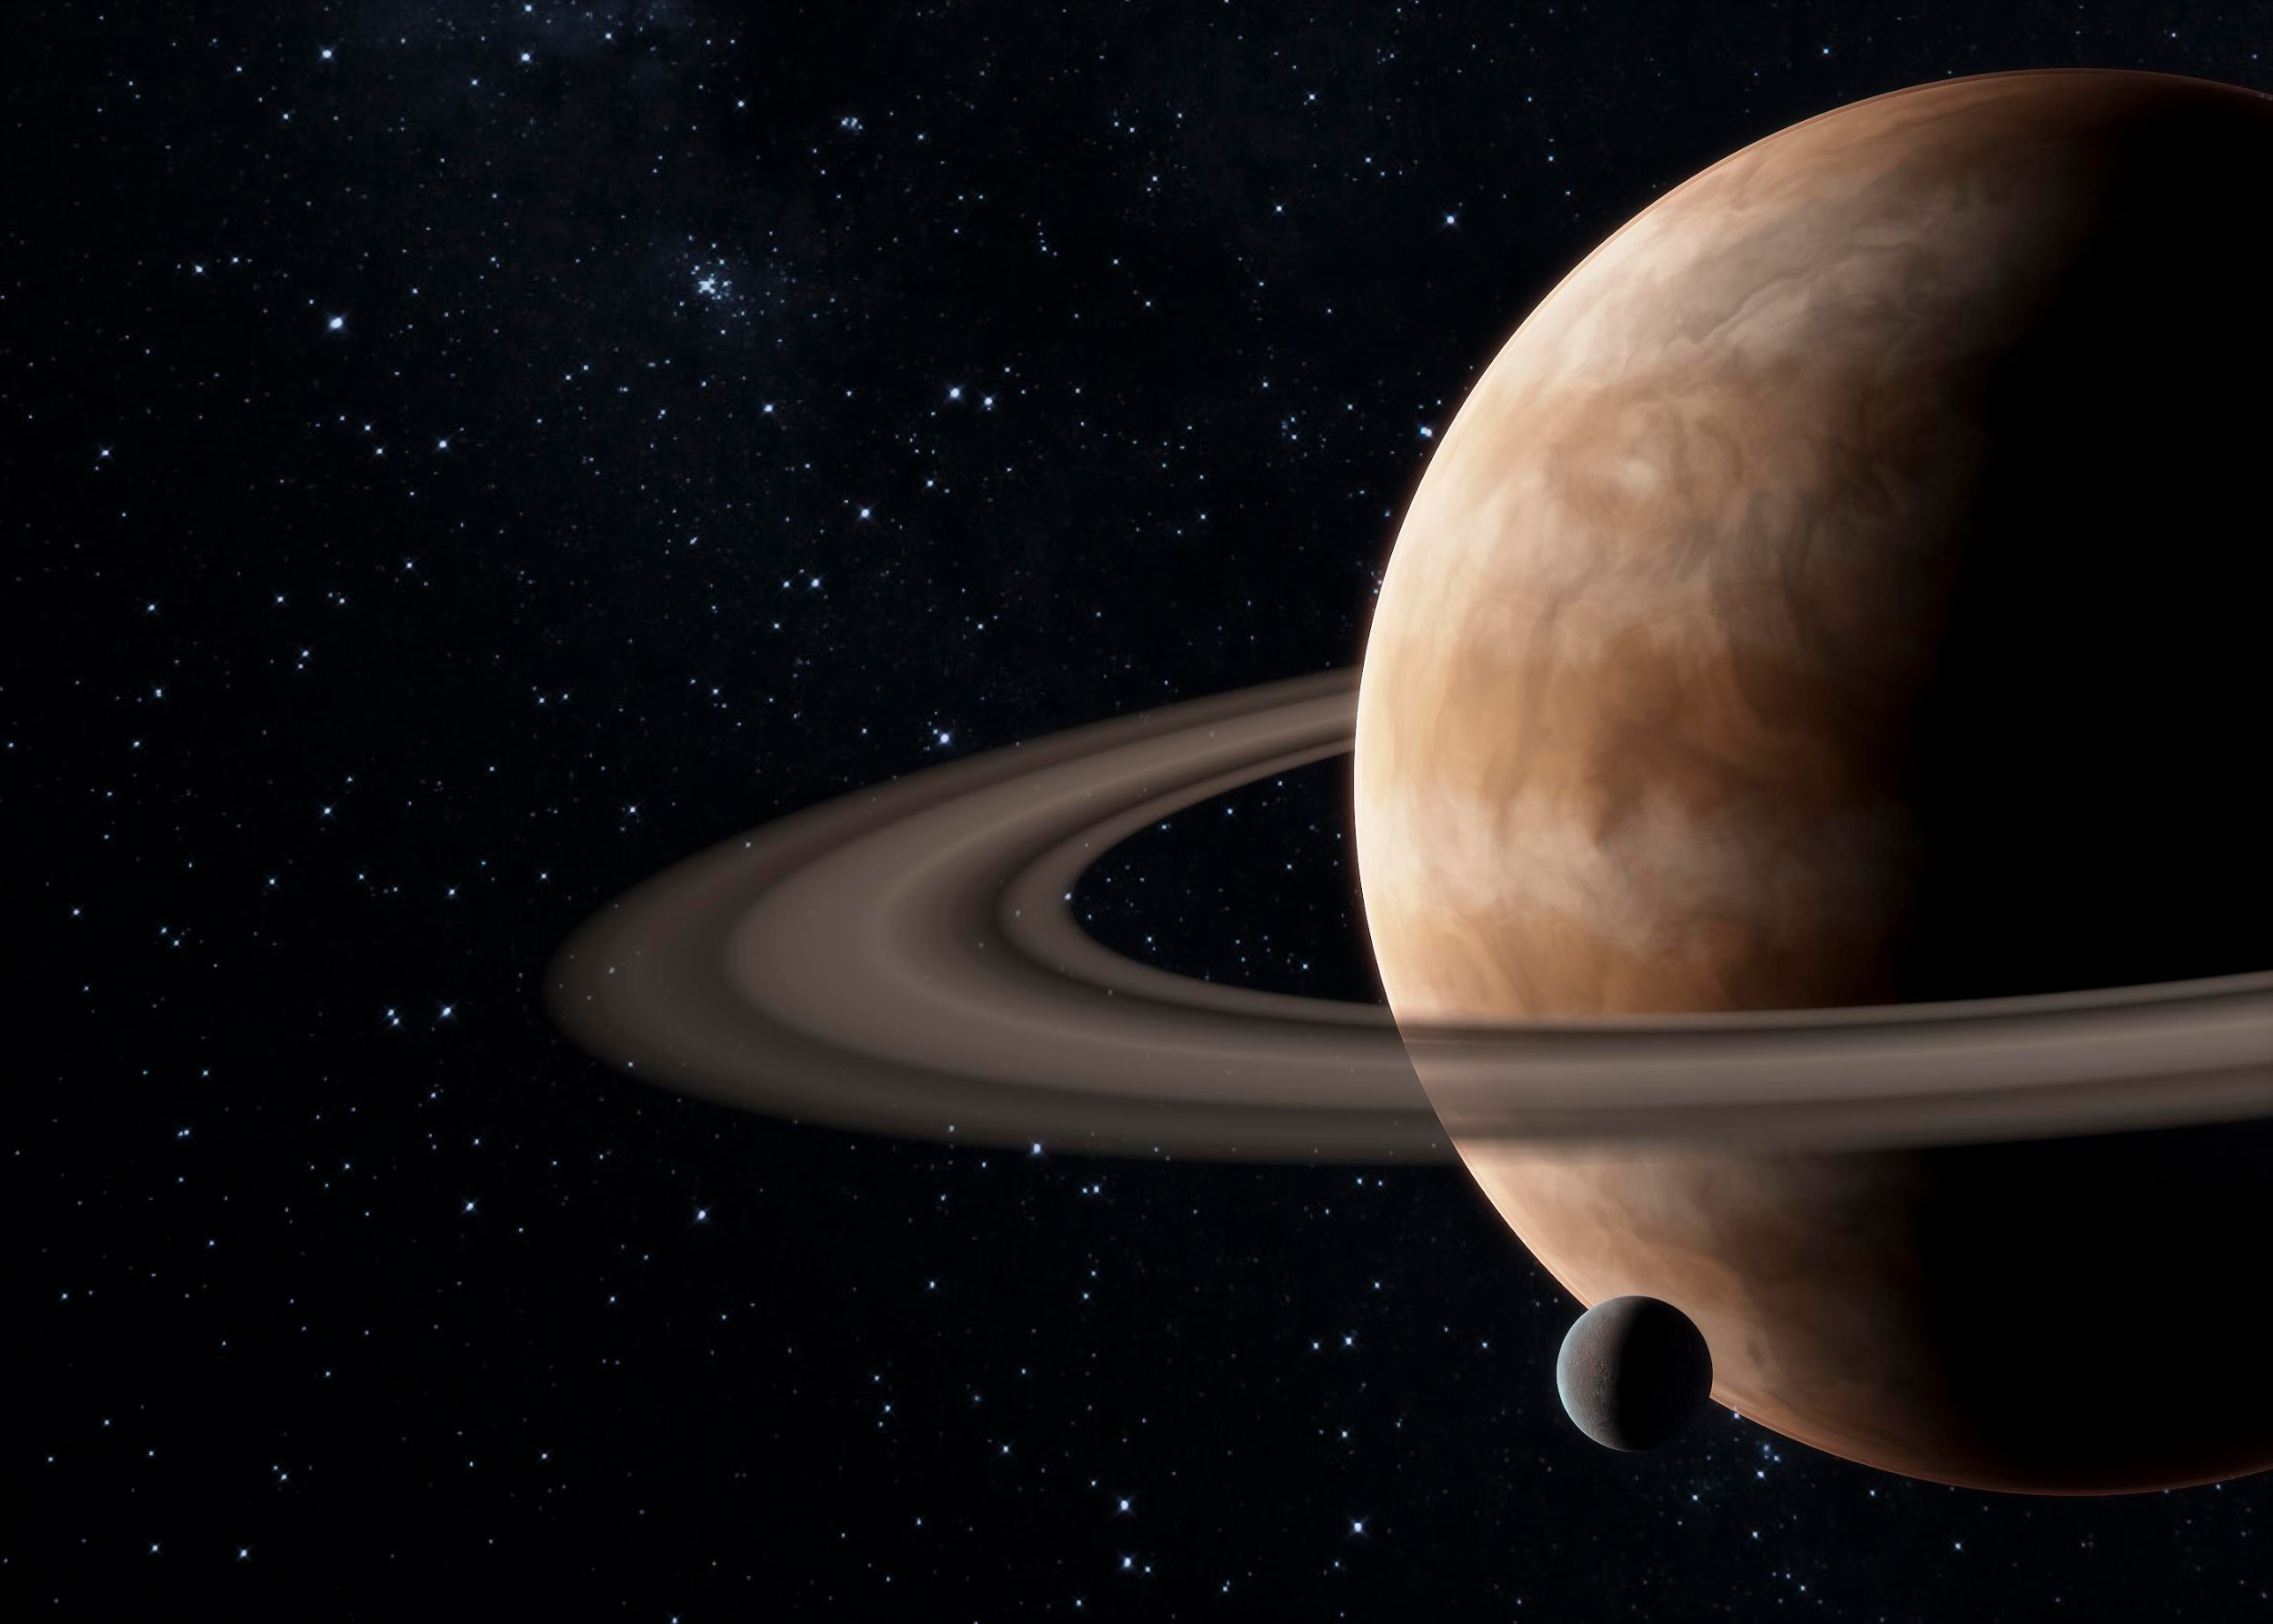
Hello
I’m Tyler, senior year astronomy student working with Dr. Eifler in Cosmology, and Dr. Shirley looking at HCN in the Taurus Molecular Cloud.

Slide 3
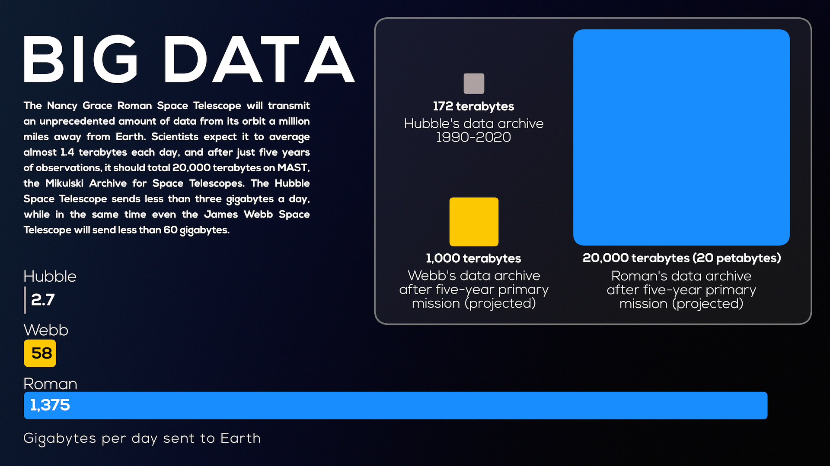
We need to be prepared for the amount of data that will be released by Roman.
Processing this data will be crucial

Slide 4
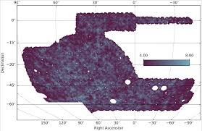
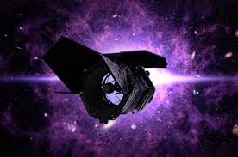
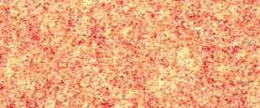
3x2 Analysis
We can correlate
DES Shear map
Galaxy positions and
Gravitational lensing.
Galaxy positions
Galaxy X Galaxy
Galaxy X Lensing
Lensing X Lensing

Slide 5
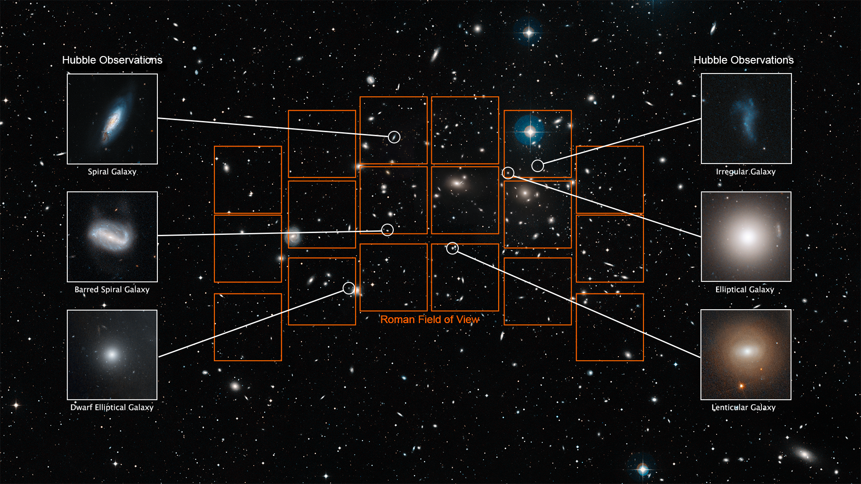

Slide 6
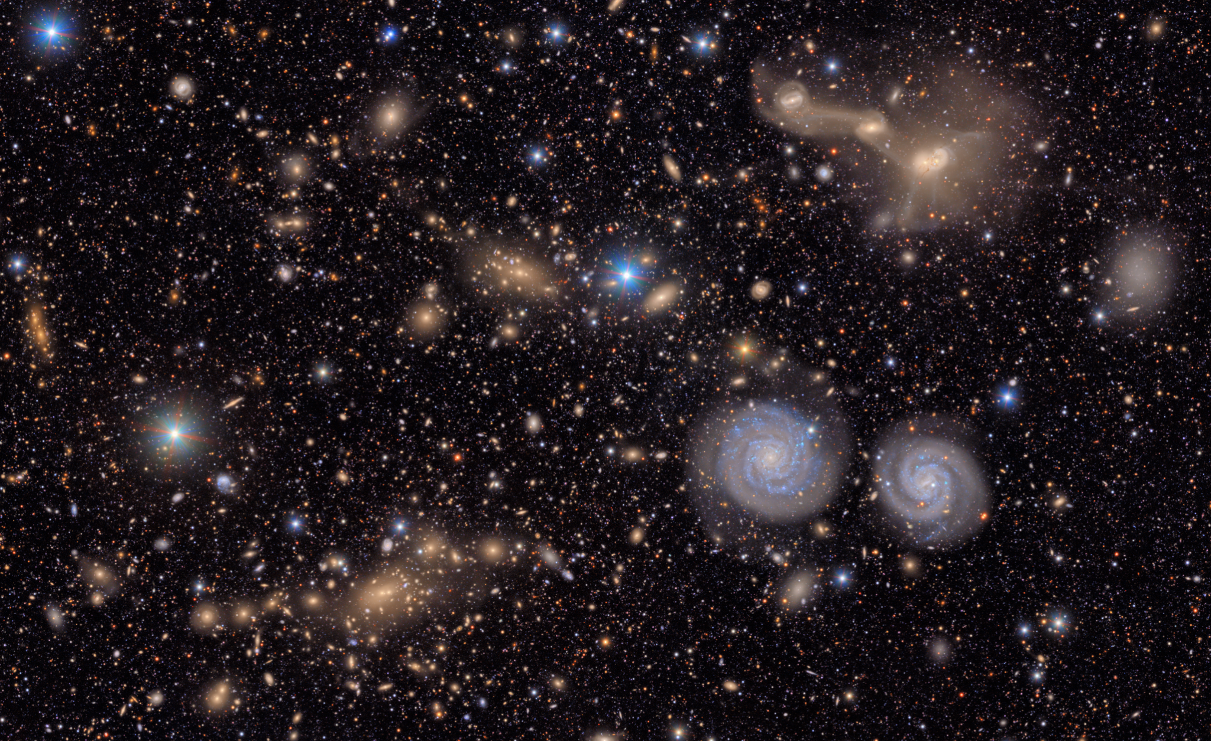
Roman Data Challenge
Install CoCoA on the HPC.
Given a covariance and data vector.
3x2 data vectors made from a simulated medium tier roman survey.
Using CoCoA run MCMC from three simulated data vectors.

Slide 7
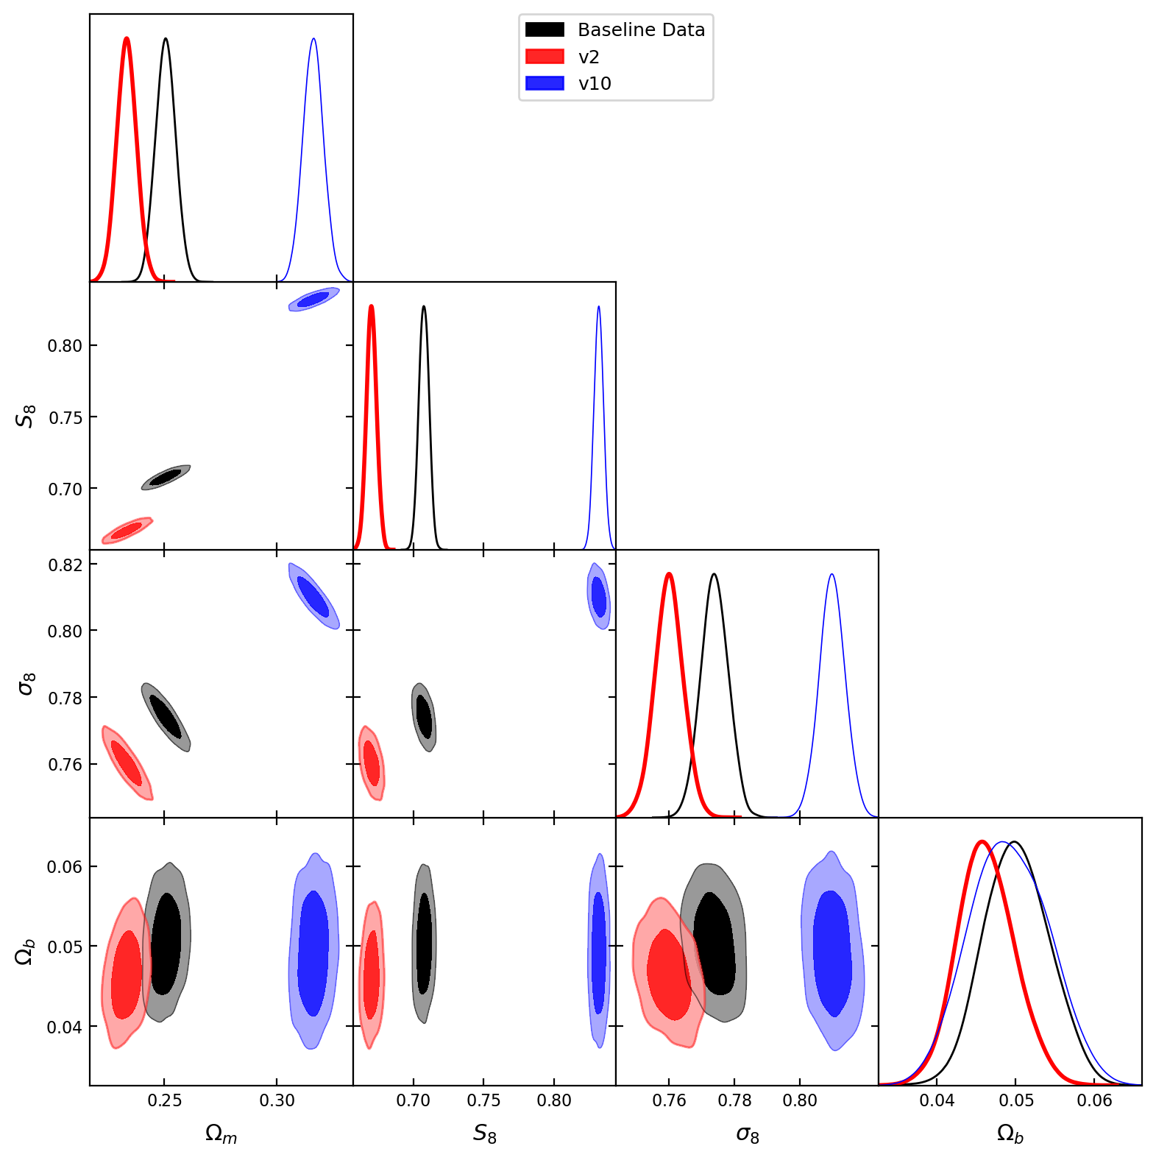
Results
Data Summary
Using ΛCDM model.
Provided three different data vectors, with the same analysis and covariance.
See difference in data vectors is the cosmological parameters

Slide 8
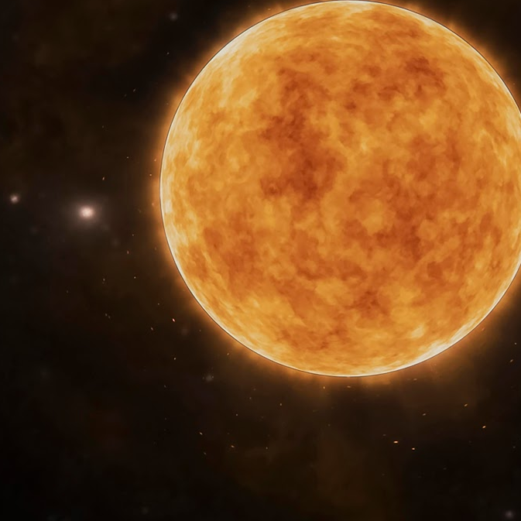
Next steps
Using Marco Raveri’s Tensiometer to quantify how these distributions differ from the data sets.
Change analysis choices in CoCoA for the same vector
  Different scale cuts for shear, galaxy clustering
  wCDM analysis on datavectors

Slide 9
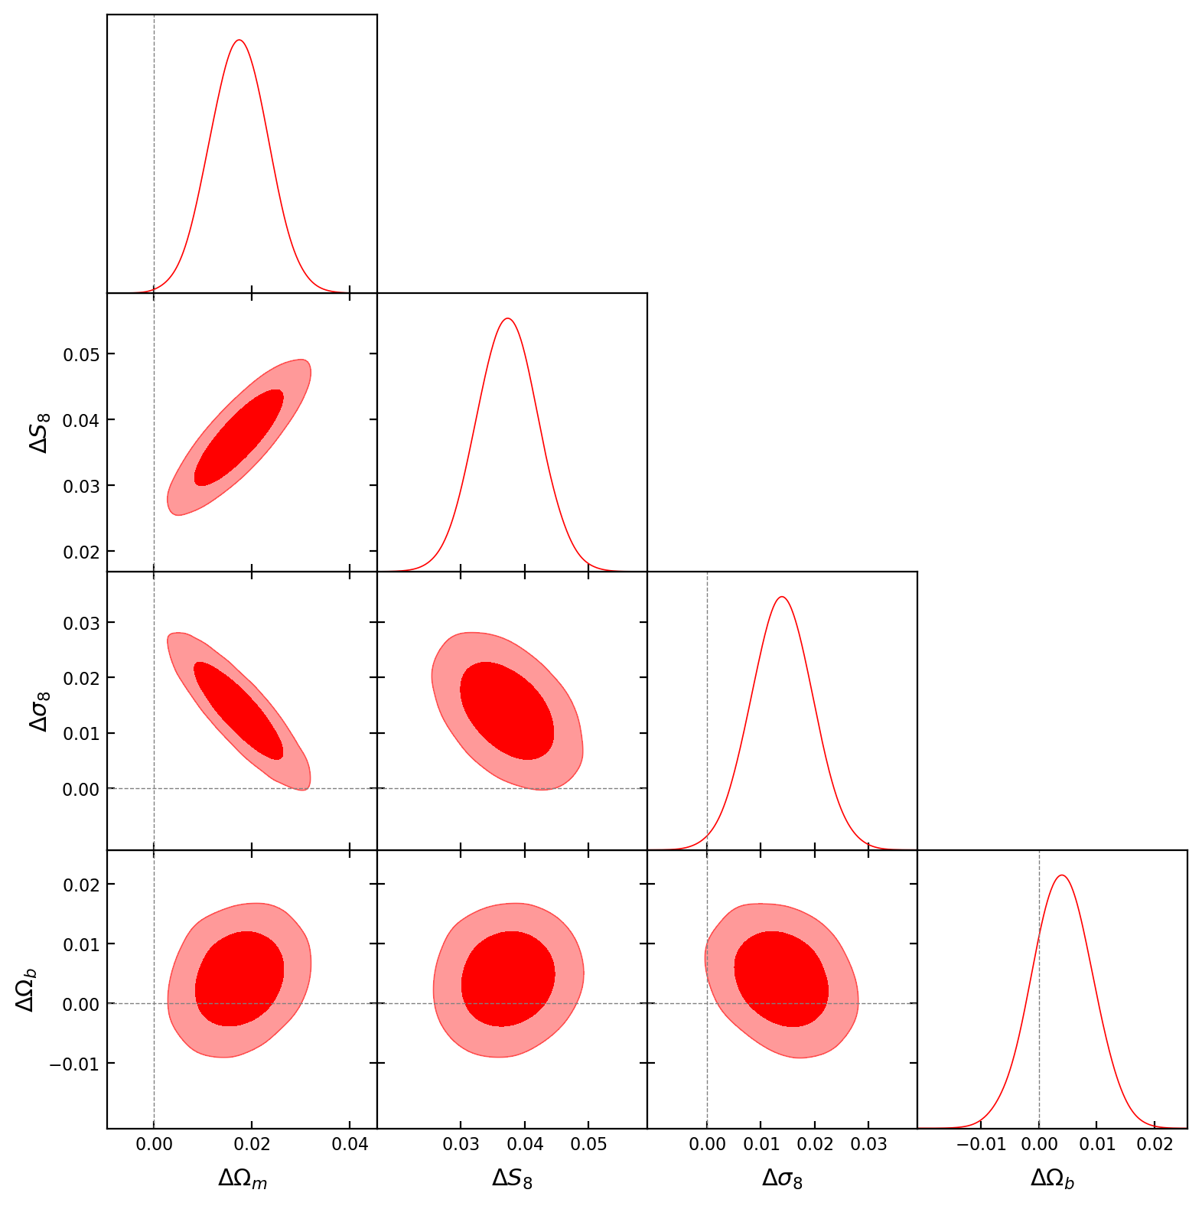
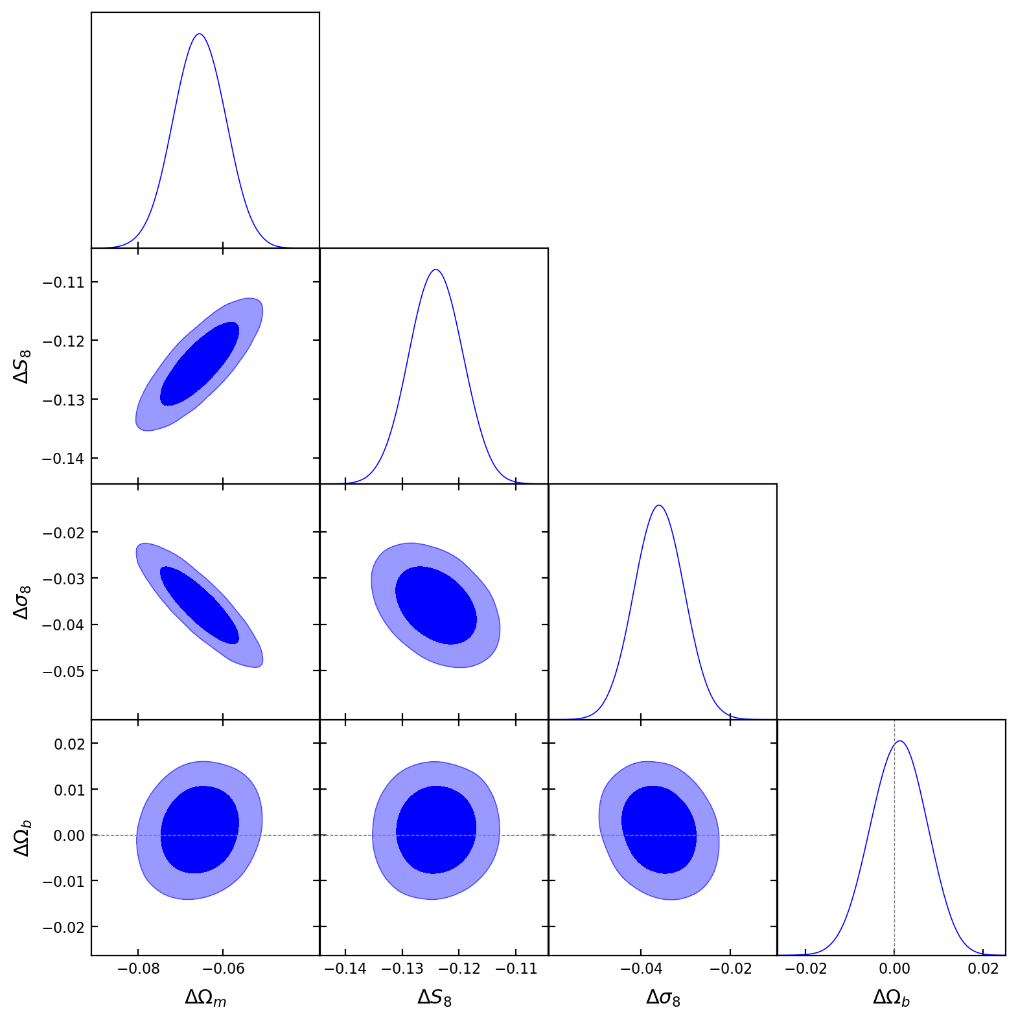
Preliminary Results
V2 difference to base
V10 difference to base

Slide 10
Thank you!

Slide 11
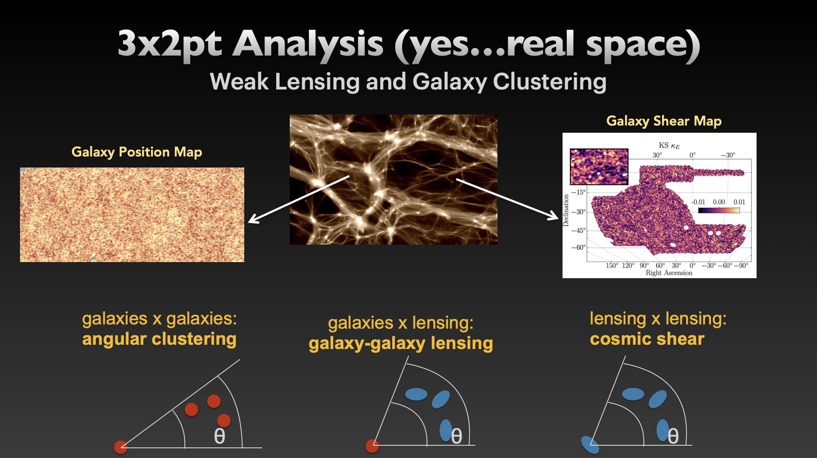

Slide 12
